Slide 1

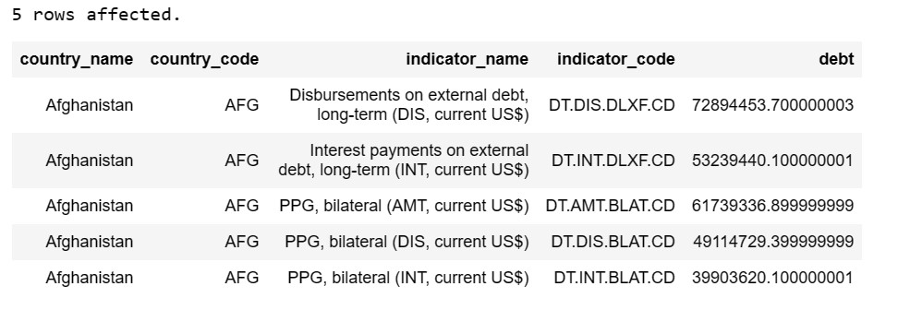
International debt table showing all columns

Slide 2

Count of Countries

Slide 3

Total debt of all Countries

Slide 4

Country with highest debt

Slide 5
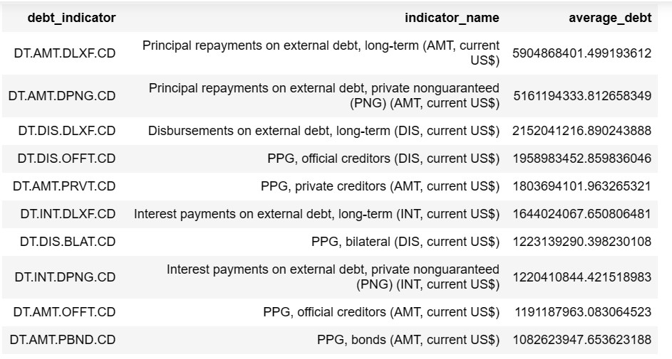
Average amount of debt owed by countries across different debt indicators

Slide 6

Country with the highest amount of principal repayments

Slide 7
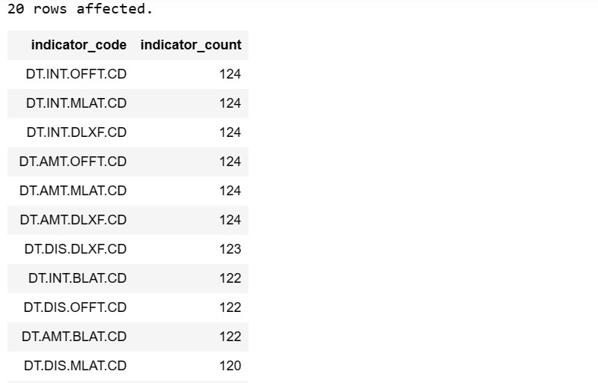
The most common debt indicator in which most countries owe their debt

Slide 8
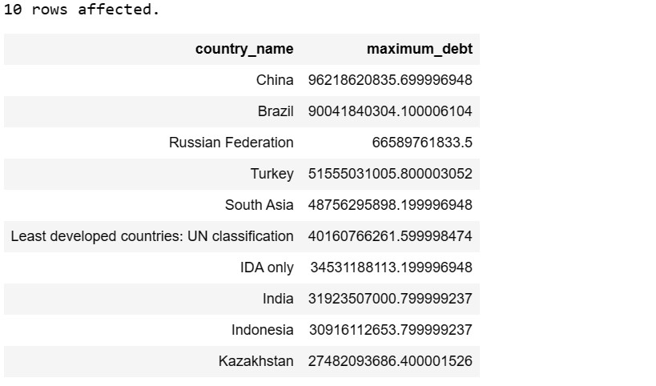
The maximum amount of debt for each country

